Slide 1

Estimation of Respiratory Rate from Breathing Audio
cv
Team Members
1DS19CS083 Mahek Tajammul
1DS19CS085 Mandhalapu Dakshitha
1DS19CS167 Srivathsa N Rao
1DS20CS409 Karthik Raju R
Under the Guidance of
Name of the Guide : Prof.Aparna M Designation:Assistant professor
Name of the Co-Guide : Ajay Kumawat Dept of Computer Science and Engineering

Slide 2
INDIVIDUAL CONTRIBUTION
cv
Mahek Tajammul 1DS19CS083 Literature Survey Project Implementation Flask application, Project Information | Mandhalapu Dakshitha 1DS19CS085 Literature Survey Project Diary Project Implementation Ml model training, Website application
Srivathsa N Rao 1DS19CS167 | Karthik Raju R 1DS20CS409
Literature Survey Project Implementation Pre processing, feature extraction Project ppt | Literature Survey Project Report Project Implementation Audio classification

Slide 3
PROBLEM STATEMENT:
A variety of practical challenges for respiratory rate estimation are raised in the setting of a telemedicine visit due to poor lighting, low video quality, and camera angle which may hinder a practitioner’s ability to manually assess a patient’s respiratory rate and increase the potential for human error.
The gold standard for measuring respiratory rate is to count a patient’s breaths over a 60 second interval. In the busy clinic or triage setting, this approach is inefficient and often abbreviated by observing breaths over shorter time intervals (e.g., 10 seconds) which can lead to inaccurate estimates. Additionally, awareness of one measuring their own respiratory rate has been shown to change a patient’s respiratory rate.
Therefore, there is an urgent need for a robust, low cost method for estimating respiratory rate for the delivery of healthcare in busy and remote telemedicine settings.
cv

Slide 4
INTRODUCTION :
The COVID-19 pandemic has established the use of telemedicine as a critical health care delivery channel that is likely to expand in the future.
A significant challenge faced in telemedicine care delivery is the accurate measurement of vital signs such as respiratory rate.
Respiratory rate, defined as the number of breaths a person takes per minute, is one of four clinical vital signs.
As such, it plays a central role in the physical examination and accurate diagnosis of patients.
Changes in respiratory rate have been shown to be an important early indicator of clinical deterioration and increased mortality in a variety of disease states.
Thus, an accurate measurement of respiratory rate is critical for assessing patient stability.
cv

Slide 5
INTRODUCTION:
One well-established automated approach for measuring respiratory rate in the monitored clinical setting is known as impedance pneumonography which measures changes in transthoracic impedance during the respiratory cycle via skin electrodes.
Yet this method requires expensive equipment that is only typically available in a monitored clinical setting such as an emergency department, intensive care unit and some general medical wards and thus does not lend itself to remote or resource-limited settings.
By contrast, an estimation system relying on audio signals alone provides an automatic, remote, and virtually free alternative for respiratory rate estimation that is amenable to hospital and telehealth settings.
Existing work in this area involves both learning-based and purely signal processing based techniques that have been used to estimate respiratory rate directly or related features like inspiration and expiration cycle boundaries which can be used for computation of respiratory rate.
cv

Slide 6

ABSTRACT:
Respiratory sound classification plays a crucial role in diagnosing respiratory diseases and monitoring patients' conditions. This project presents a code implementation for respiratory sound classification using machine learning techniques. The code utilizes audio processing libraries, including Librosa, to extract relevant features from respiratory sound recordings.
These features are then used as input to a Convolutional Neural Network (CNN) model implemented using TensorFlow and Keras.The code's main functionality is to classify the respiratory sound recordings into different categories based on the extracted features. The provided code includes a Flask-based web application that allows users to upload respiratory sound recordings for classification. The uploaded audio file is processed using the pre-trained CNN model to predict the respiratory sound class.
Additionally, the code determines the respiratory rate from the predicted class and classifies it as normal or abnormal based on a defined threshold.The system requirements for running the code include Python, along with the necessary libraries such as Flask, Librosa, NumPy,
scikit-learn, TensorFlow, and Keras.
cv

Slide 7
ABSTRACT:
An audio dataset is assumed to be present in a specific directory, and the code expects the path to the pre-trained model to be provided. The code can be adapted for different datasets and model architectures based on specific research requirements.Experimental evaluations can be conducted by modifying the code to train the CNN model using the provided dataset.
The code splits the dataset into training and testing sets, performs preprocessing steps such as normalization and encoding of labels, and trains the CNN model on the training data. The model's performance is evaluated using accuracy metrics on the test set.
The provided code serves as a valuable resource for researchers and practitioners working on respiratory sound classification. It offers a starting point for implementing similar systems and conducting experiments related to respiratory sound analysis.
By leveraging the power of machine learning techniques, this code contributes to the advancement of respiratory healthcare by providing a tool for automated respiratory sound classification and analysis.
cv

Slide 8
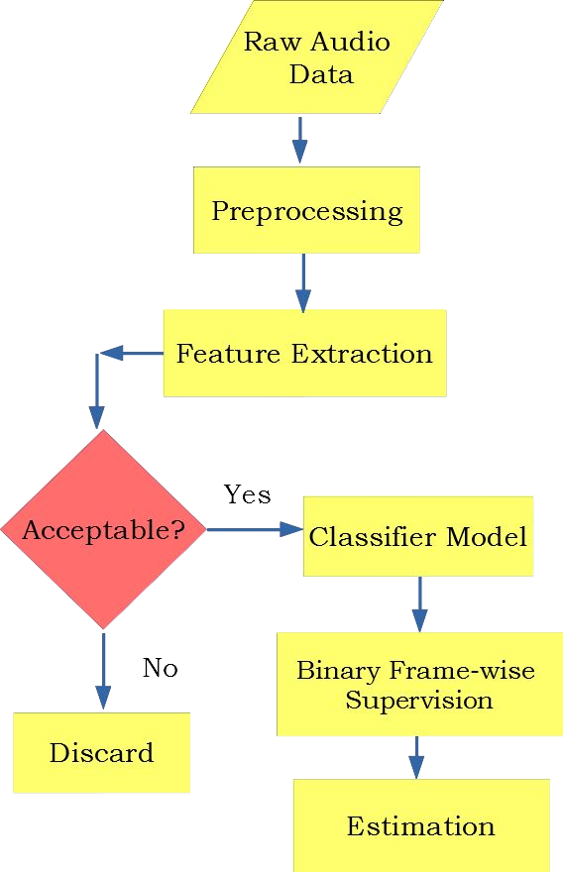
METHODOLOGY:
cv

Slide 9
METHODOLOGY :
Feature Extraction:The `extract_features` function is responsible for extracting audio features using the librosa library. It computes the Mel spectrogram for the audio file. The Mel spectrogram is a representation of the audio signal in the frequency domain. It uses a mel-scale to convert the linear frequency scale to a scale that better represents human auditory perception. The extracted features are then padded or truncated to a fixed length defined by `max_length`.
Model Training:The code snippet for model training involves several steps:- It loads the audio files from the dataset directory and extracts features for each file using the `extract_features` function.- The features and corresponding labels (extracted from the filename) are stored in
`features` and `labels` arrays, respectively.- The label encoder is used to encode the categorical labels into numerical values.- The dataset is split into training and testing sets using the `train_test_split` function.- The features are normalized by subtracting the mean and dividing by the standard deviation.- The labels are one-hot encoded using the
`to_categorical` function
cv

Slide 10
METHODOLOGY :
The input data is reshaped to match the expected input shape of the convolutional neural network (CNN) model.- A CNN model is defined using the Keras Sequential API. It consists of convolutional, max pooling, flatten, and dense layers.- The model is compiled with an optimizer, loss function, and evaluation metric.- The model is trained on the training data using the `fit` function.
cv
3. Audio Classification:The Flask web application provides an interface for uploading audio files and classifying them using the trained model:- The `classify_audio` function is triggered when an audio file is uploaded. It saves the uploaded file, loads the trained model and label encoder, and calls the `extract_features` function to extract features from the uploaded audio file.- The extracted features are preprocessed (normalized) and reshaped to match the input requirements of the model.- The model predicts the class probabilities using the `predict` method.- The predicted class index is obtained by finding the index of the highest probability.- The label encoder is used to invert the encoding and get the predicted label.-

Slide 11
METHODOLOGY :
A respiratory rate mapping is defined to map the predicted label to a respiratory rate value.- Based on the respiratory rate and a threshold value, the classification is determined as "Normal" or "Abnormal."- The uploaded audio file is deleted, and the classification result is returned as a JSON response.
4.Flask app :
In the Flask app, the uploaded audio file is saved and passed to the
`extract_features` function to obtain the features. The features are reshaped and preprocessed to match the requirements of the trained model. The model is then used to predict the class probabilities for the given audio. The predicted class index is converted back to the original label using the `label_encoder` object.A respiratory rate mapping is defined to map the predicted label to a respiratory rate value. If the respiratory rate is below or equal to a specified threshold, the classification is considered "Normal"; otherwise, it is labeled as "Abnormal". The classification result is returned as a JSON response to the frontend.Finally, the uploaded audio file is deleted to clean up the temporary storage.
cv

Slide 12
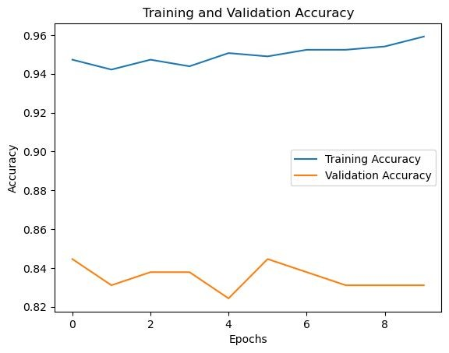
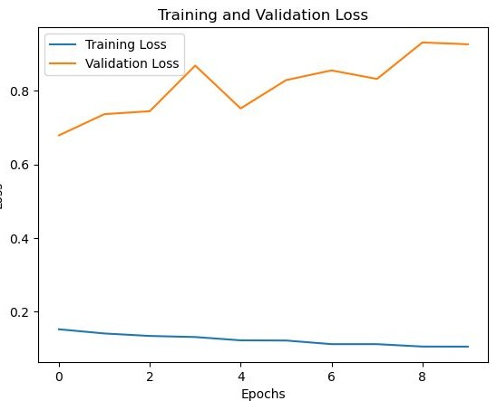
OUTPUT:
cv

Slide 13
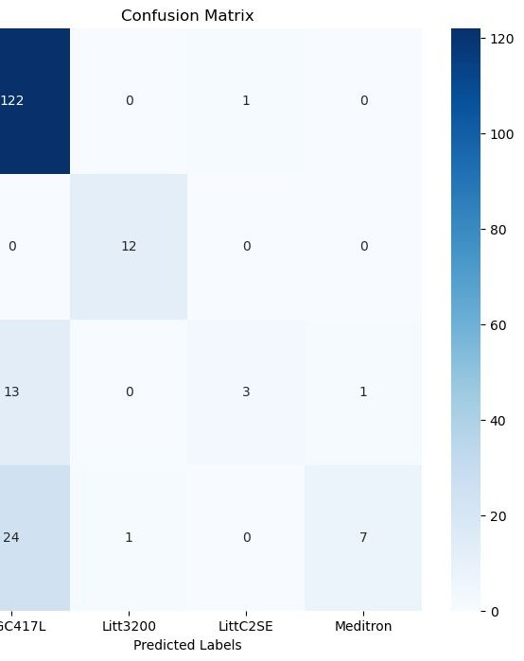
OUTPUT:
cv

Slide 14
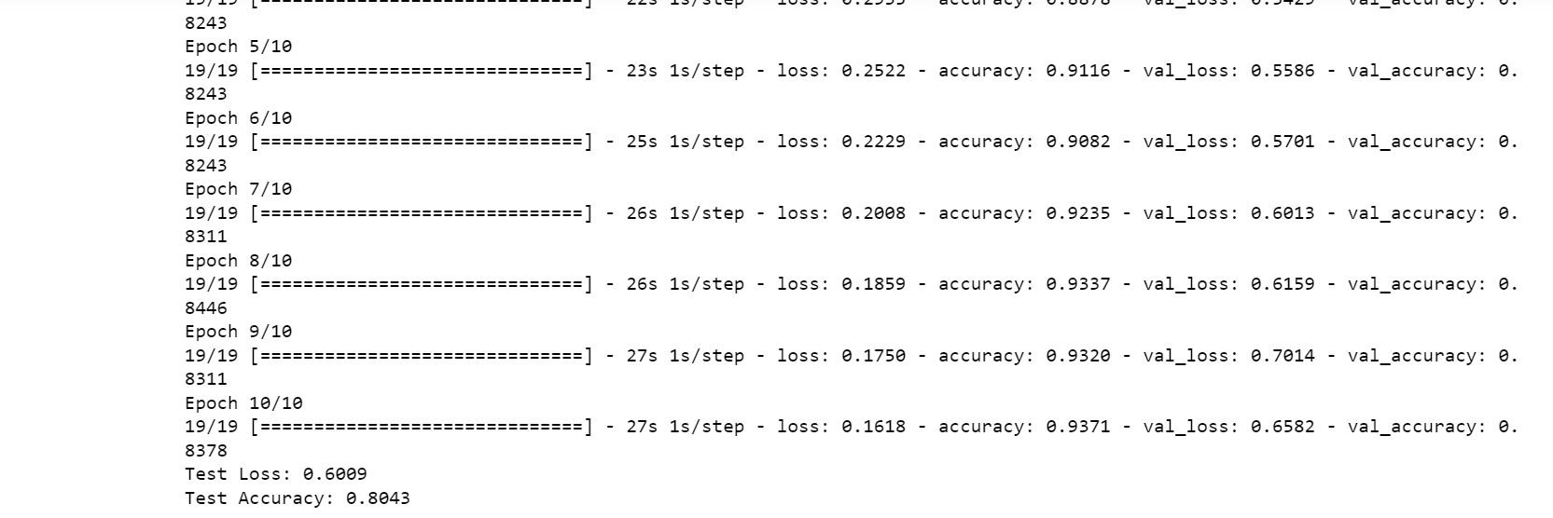
OUTPUT:
cv

Slide 15
CONCLUSION:
The advantages of our proposed method,which performs exceptionally well with very few labeled training examples, are enhanced by the fact that the ICBHI Respiratory Sounds Database is the only publicly available database of labeled respiratory sounds.
Using the proposed method, a supervised respiratory rate estimation system can be built with little data. As a consequence of this, the creation of this software might lead to an estimation of human respiration rates that is simple, precise, and highly efficient.
Given that the ICBHI Respiratory Sounds Database is the only known public database of labeled respiratory sounds, and is relatively small, our proposed approach offers added benefit by performing extremely well with very few labeled training examples.
The proposed approach demonstrates how a supervised respiratory rate estimation system can be built within a low-data setting. Hence, Development of this software can lead to an easy, accurate and highly efficient estimation of Respiratory rates of human beings.
cv

Slide 16
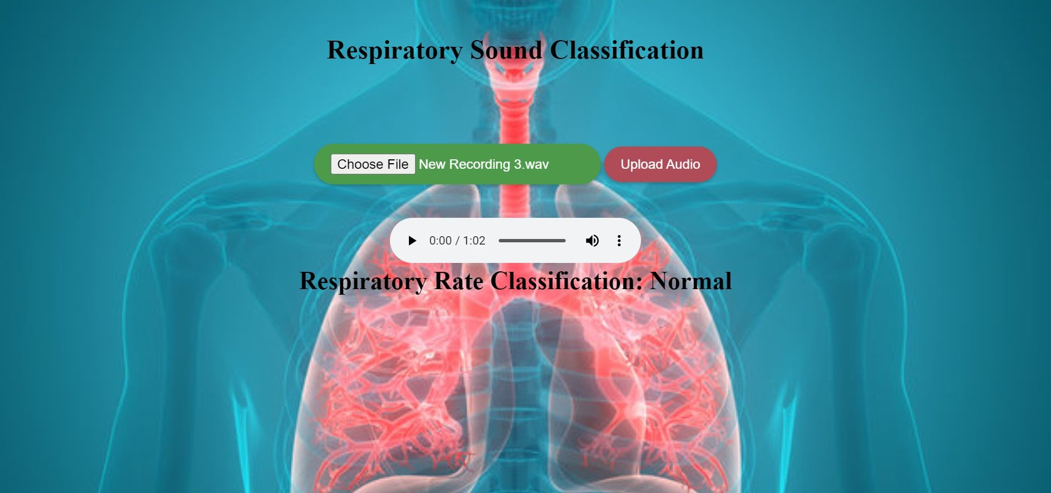
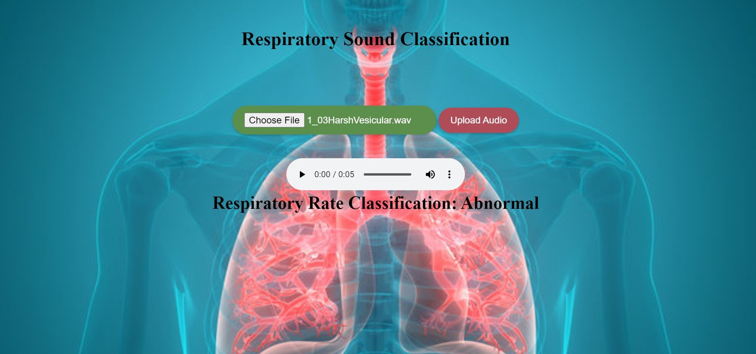
SCREENSHOT :
cv

Slide 17
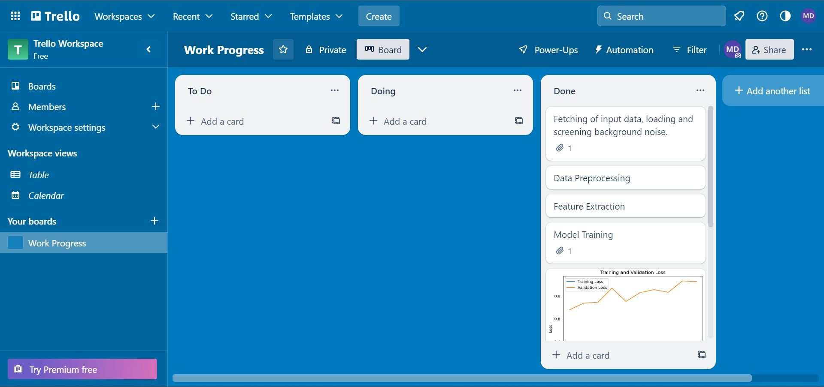
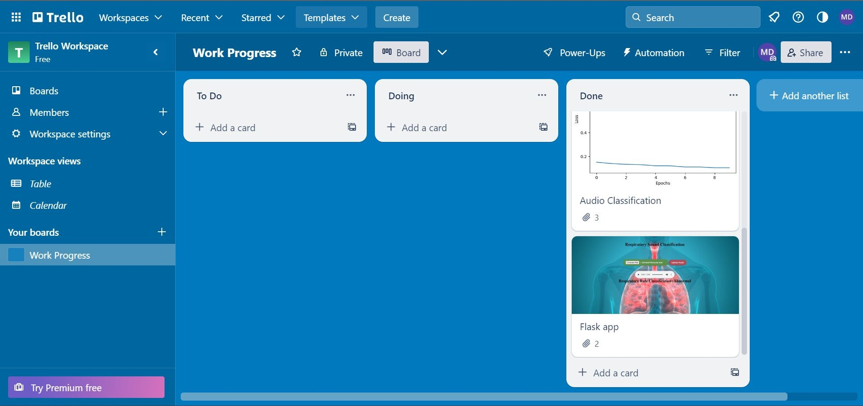
PROJECT MANAGEMENT TOOL :
cv

Slide 18
Co-Guide Suggestions/Improvements
January 12th 2023 ( Phase 1 review 1)
Asked us to set up a criteria for evaluating respiratory rate so that we can have cross over between different methods and select the best one.
January 27th 2023 ( Phase 1 review 2)
In the next meeting, we created a table of comparision between different methods and the co-guide praised us for the same
Literature Survey review with the co-guide where we explained the related papers and showed the methodologies in those papers and the possibilities of us using those methodologies in our project implementation.
April 10th 2023 ( Phase 2 review 1)
In the phase 2, review 1.
The co-guide suggested that we can take the averages of the before and after graphs so that the difference in the accuracy can be seen.
Also, the co-guide suggested, if possible to divide the dataset into two halves and carry out the process and check what will be the results.
cv

Slide 19
Thank You
cv

